Slide 1
Hack the Future:
A Gen AI Sprint Powered by Data

Slide 2

Guidelines
The template should consist of the following and it is mandated to be used by your team for submitting your innovative ideas/solutions. Follow file naming format: She codes_Smart Cart.pptx

Slide 3





Hack the Future: A Gen AI Sprint Powered by Data
Data and AI Week
Team details
TEAM NAME:SheCodes
S . Thahaseen (Team Leader)
S. Usha sree
Photo

Slide 4
Entry Submission Summary
Idea Title (Provide a concise and impactful title for your idea.) | Smart Cart: Personalized AI Shopping Assistant
Team Name | She codes
Problem Statement | In the competitive world of e-commerce, providing personalized and relevant product recommendations is key to improving customer experience, increasing conversion rates, and boosting sales. In this challenge, your task is to build a multi-agentic AI system that delivers hyper-personalized product recommendations for an e-commerce platform. This system will utilize different agents representing customers, products, and recommendation engines, all collaborating to analyze browsing behavior, predict user preferences, and optimize the overall shopping experience. Your Data & AI system should enable the e-commerce platform to deliver tailored recommendations based on each customer's behavior and interests, ultimately improving engagement, increasing average order value, enhancing customer retention, and driving higher conversion rates.
Proposed Solution | Our solution is a Smart Shopping Recommender System designed to deliver hyper-personalized product recommendations on an e-commerce platform. It is built using a multi-agent architecture where individual agents represent customers, products, and recommendation engines, working together to analyze user behavior and optimize the shopping experience. The backend is developed with FastAPI, ensuring fast and scalable API responses, while the frontend uses Streamlit to provide an interactive user interface. Product data is stored in a SQLite database and includes details such as names, prices, and images. When a user selects their ID, the system fetches and displays tailored product recommendations in real-time, creating a seamless and engaging experience aimed at increasing conversion rates and customer satisfaction.

Slide 5
Problem statement you are trying to address
Problem statement 2: Smart shopping: Data and AI for Personalized E-Commerce
In the competitive landscape of e-commerce, delivering personalized and relevant product recommendations is critical for improving customer satisfaction, increasing engagement, and driving sales. However, many platforms still rely on generic suggestions that fail to reflect individual preferences, leading to poor user experience and reduced conversion rates. This project aims to address this gap by building a multi-agent AI system that leverages customer behavior data to provide hyper-personalized product recommendations, ultimately optimizing the online shopping journey.

Slide 6
Proposed solution Overview
Our project, Smart Shopping Recommender, is an AI-powered web application designed to enhance the online shopping experience through intelligent product recommendations. The solution uses a FastAPI backend to serve product data from an SQLite database and a Streamlit-based frontend that allows users to interact with the system seamlessly. Upon selecting their user ID, customers receive a curated list of recommended products, complete with images, names, and prices, displayed in a clean and engaging UI.
This system addresses the core problem of decision fatigue and inefficient browsing in online shopping by offering a personalized and intuitive experience. It simulates real-world smart recommender systems used by e-commerce platforms like Amazon or Flipkart. The architecture is modular, allowing easy scalability for future enhancements like user profiling, advanced recommendation algorithms, and integration with third-party APIs.

Slide 7
Technologies used
Python – Core programming language used for backend logic and data handling.
FastAPI – Lightweight and high-performance backend framework to build RESTful API for product recommendations.
SQLite – Lightweight relational database to store product information such as name, price, and image URL.
Streamlit – Easy-to-use Python framework to create an interactive web frontend for users to receive recommendations.
Unsplash – Source of product images to visually enrich the shopping experience.
Uvicorn – ASGI server used to run the FastAPI backend with automatic reloading.

Slide 8
Agents' interaction design
In our system, two main agents interact to deliver personalized shopping recommendations:
User Agent (Frontend) – This agent is built using Streamlit. It allows users to select their ID and triggers a request to fetch personalized product recommendations. It is responsible for presenting the recommended items in an interactive and user-friendly interface.
Recommendation Agent (Backend) – Powered by FastAPI, this agent handles incoming requests from the frontend, queries the SQLite database for product information, and returns a list of product recommendations. It ensures smooth and efficient data handling and communication.
These agents work collaboratively: the frontend captures user input, the backend processes it and returns relevant data, and the frontend displays the results in real time.

Slide 9
Code structure
create_db.py – Initializes the SQLite database with product data
update_products.py – Updates product image URLs and prices
main.py – FastAPI backend that provides product recommendations
app.py – Streamlit frontend for user interaction
users.db – SQLite database storing all product details
README.md – Documentation for project setup and usage
requirements.txt – List of dependencies

Slide 10
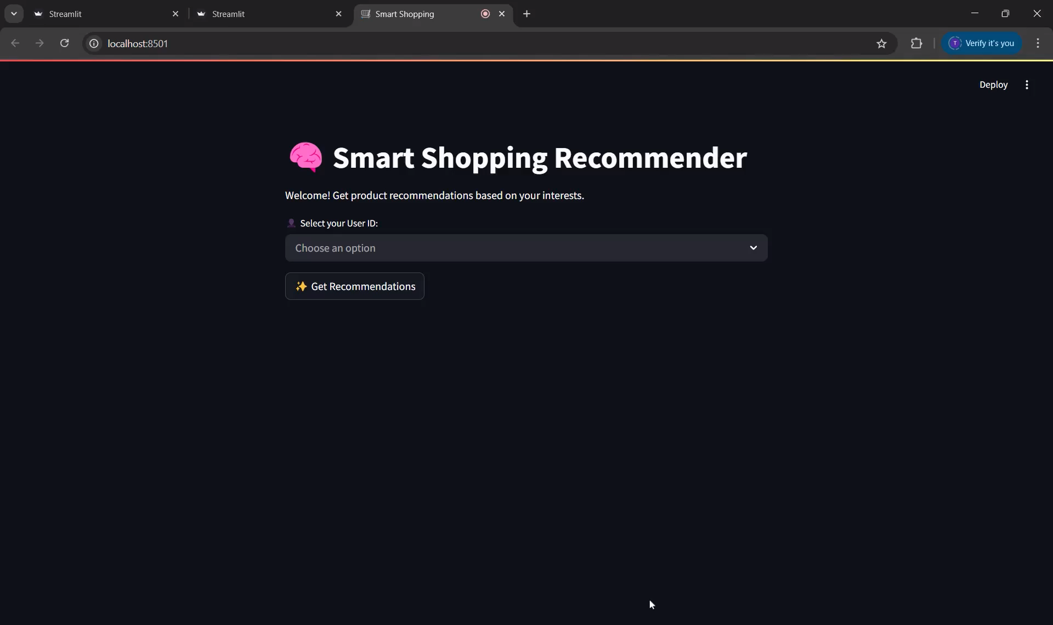
Demo video

Slide 11
Conclusion
The Smart Shopping Recommender system successfully addresses the challenge of delivering hyper-personalized product suggestions in an e-commerce environment using a multi-agent AI approach. By simulating the interactions of various intelligent agents—such as customer behavior analyzers, recommendation engines, and product data handlers—our solution creates a dynamic and intelligent recommendation pipeline that evolves with each user’s actions.
This system not only enhances the overall user experience by offering relevant and timely suggestions but also benefits the business by increasing engagement, reducing bounce rates, and improving conversion and retention metrics. The architecture is designed to be modular and scalable, making it easy to integrate with larger retail systems or expand across domains.
Through the use of FastAPI, Streamlit, and SQLite, we’ve ensured that the system is lightweight, responsive, and developer-friendly. This project demonstrates the real-world potential of AI-powered personalization in e-commerce and serves as a foundation for more advanced recommender systems in the future.

Slide 12
References/Other details
FastAPI Documentation – For building the backend API.
Streamlit Documentation – For developing the interactive frontend interface.
SQLite Official Docs – Lightweight database used for product and user data.
Unsplash – For product images used in the demo.
Python Documentation – General language references and libraries.
Requests Library – Used for API communication between frontend and backend.

Slide 13
Thank You

